Slide 1
Cloud Computing Project - Part B Customer Churn Prediction
Group 4
Vishal Bakshi
Srivallabh Siddharth Nadadhur
Kusum Sai Chowdary Sannapaneni

Slide 2
Scope
The project leverages Amazon Sagemaker and Amazon Quicksight to predict and analyze bank customer churn, identifying key churn drivers for targeted retention strategies.

Slide 3








Architecture
Amazon Sagemaker
Notebook
Data Preprocessing
Model Training
Kaggle
S3 Bucket
Model
Amazon QuickSight
Exploratory Data Analysis

Slide 4
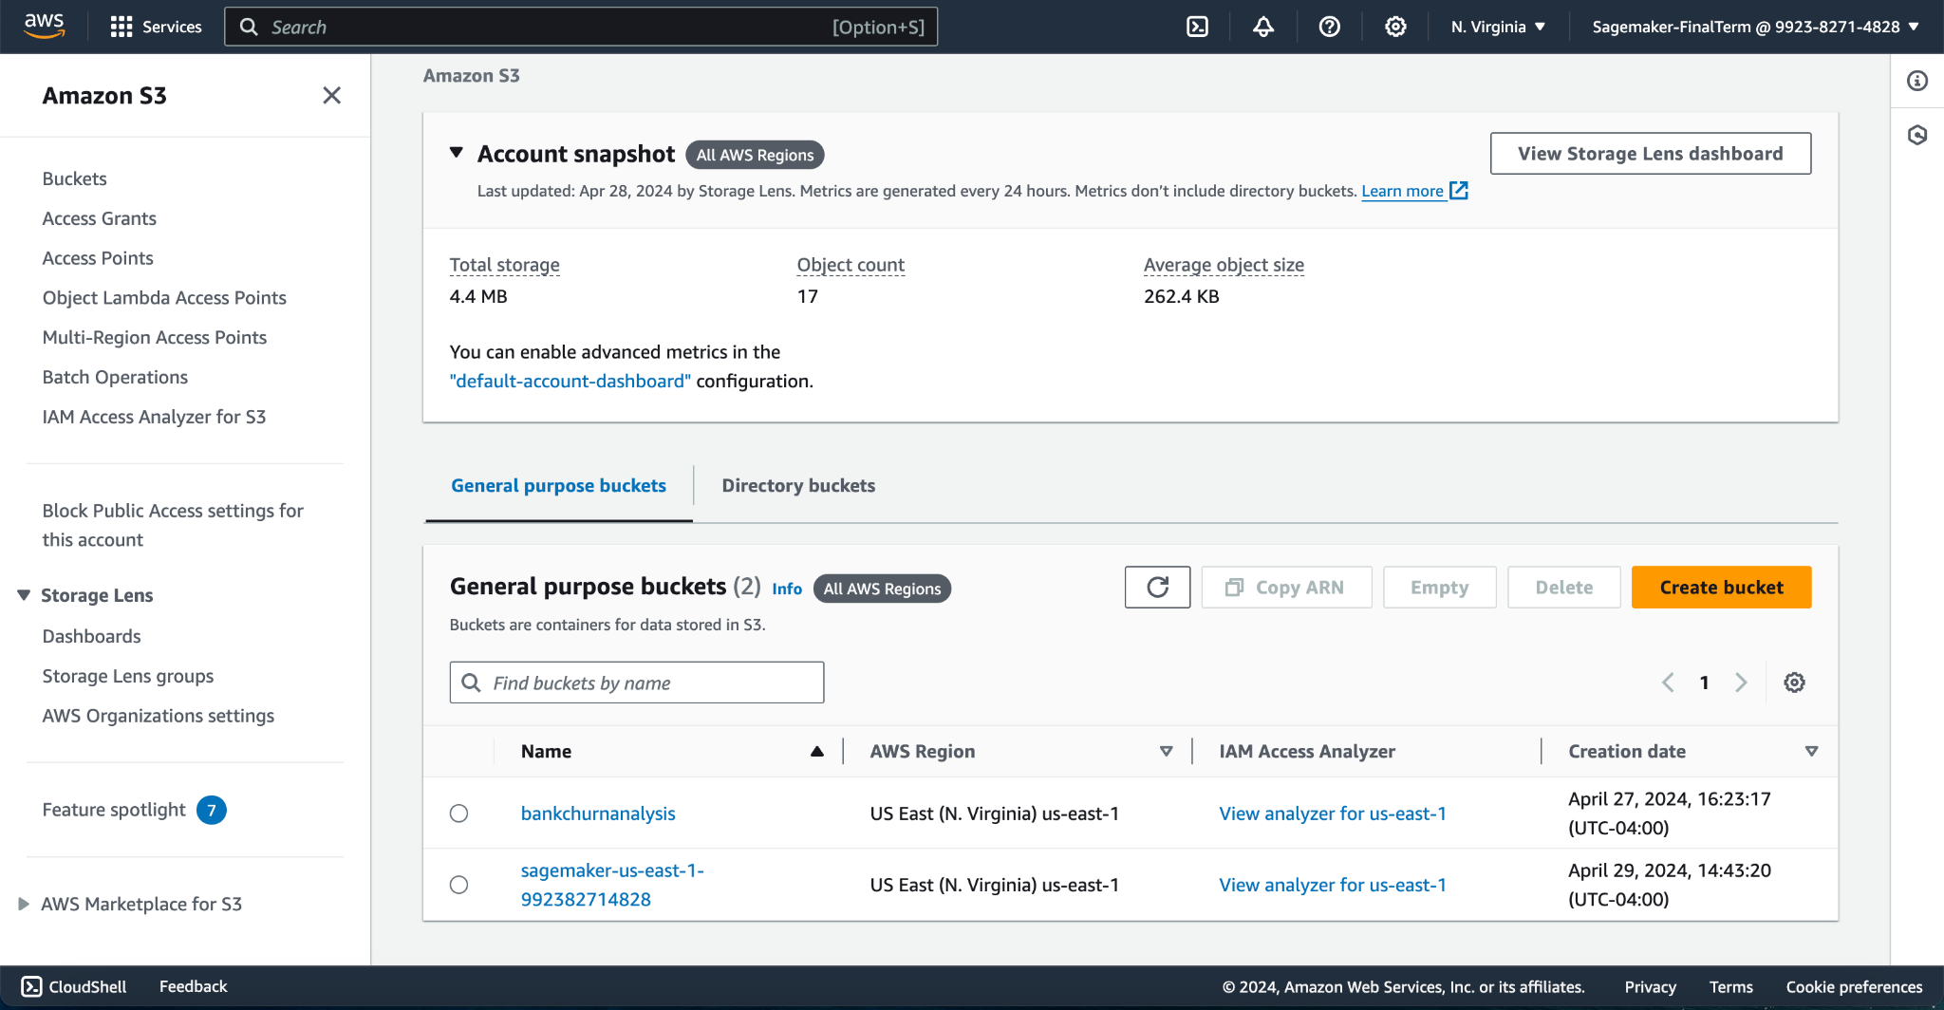
S3 Bucket
Amazon S3 is Used to store our dataset named Bank Churners

Slide 5
Quicksight Analysis
Amazon QuickSight was integral to our data analysis process, providing a platform to access and explore the raw data stored in "Bank_Churners.csv". By leveraging QuickSight interactive data visualization tools, we conducted thorough exploratory data analysis (EDA), which played a crucial role in understanding the underlying patterns and trends in the dataset.

Slide 6
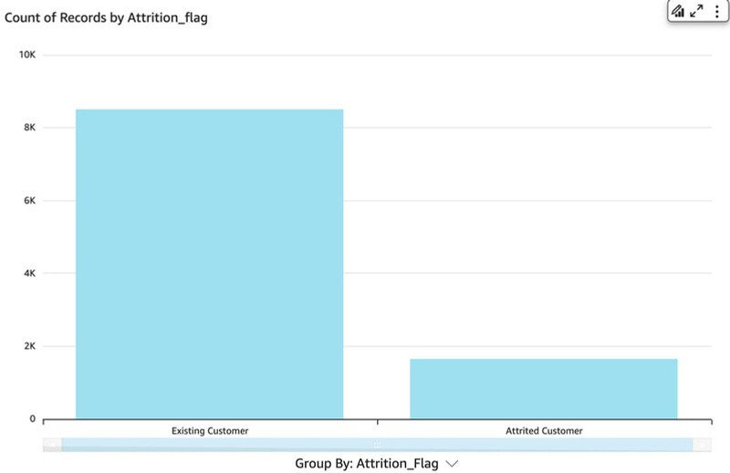
Count Plot: Existing vs Attrited Customer
The graph shows the distribution of customers by their attrition status - either Existing Customer or Attrited Customer.
There is a noticeable imbalance between the two categories, with Existing Customers vastly outnumbering Attrited Customers.

Slide 7
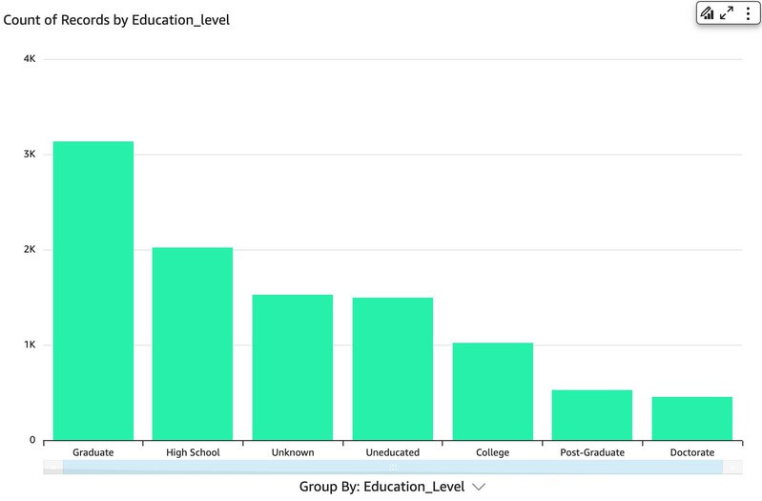
Frequency of Education Level
The bar chart shows the count of records grouped by various education levels, with "Graduate" being the largest group, followed by "High School" and "Unknown."
The categories "Post-Graduate" and "Doctorate" have the fewest records, suggesting a smaller representation in this dataset.

Slide 8
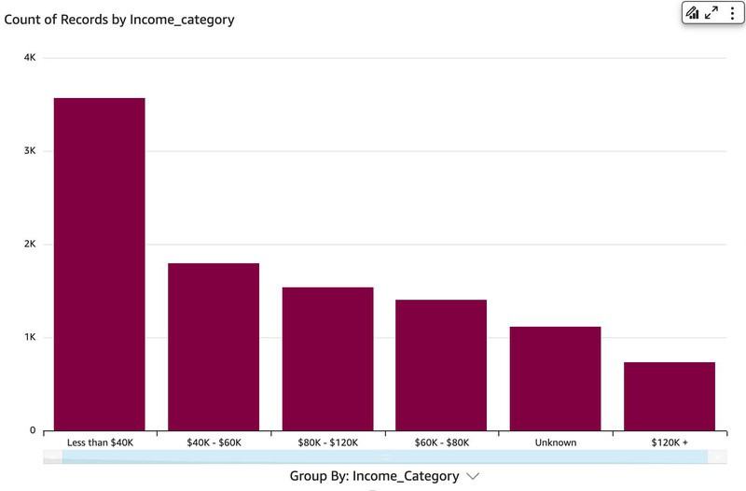
Frequency of Income Category
Income Distribution: The bar chart shows the count of records categorized by income levels. Individuals earning less than $40K make up the largest category, followed by those in the $40K-$60K and $80K-$120K ranges. This indicates a concentration of lower and middle-income groups.

Slide 9
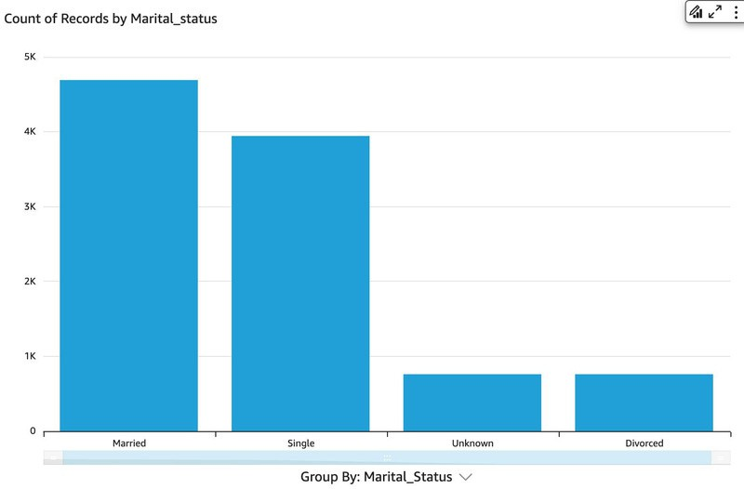
Frequency of Marital Status
The dataset predominantly consists of married and single individuals, with fewer records for divorced and unknown categories.

Slide 10
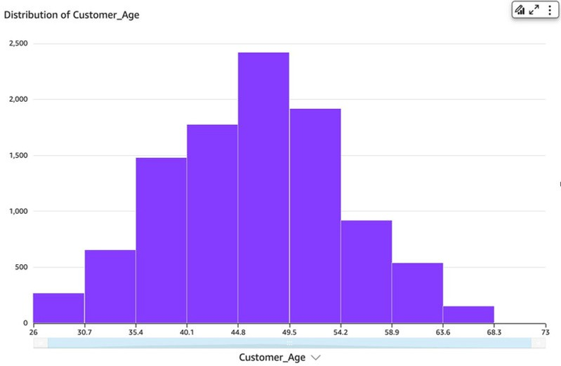
Customer Age Spread
Overall Interpretation: The customer base seems to be middle-aged, with a balanced age distribution. This might reflect a broad appeal of the bank's services across different age groups.

Slide 11
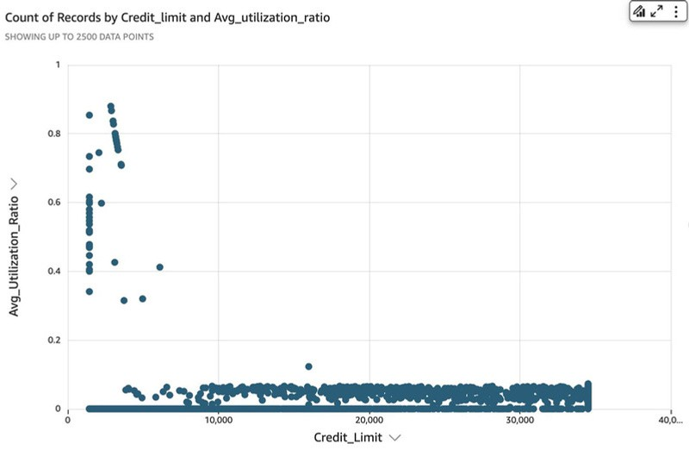
Credit Limit vs Avg Utilization Ratio
Low Utilization Ratio: The scatter plot reveals that most credit card users have a low average utilization ratio across various credit limits, indicating minimal use of their available credit.
High Utilization Outliers: A few outliers show higher utilization ratios, especially at lower credit limits, suggesting that some users heavily rely on their credit within these ranges.

Slide 12

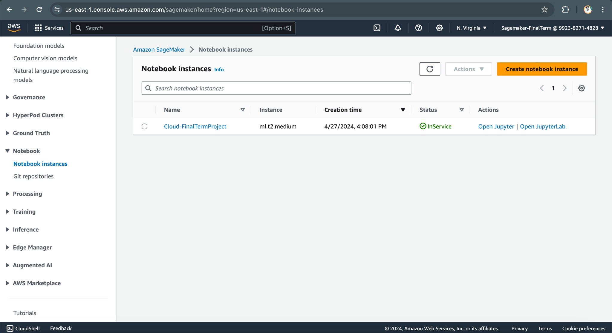
SageMaker
Amazon SageMaker was employed to manage the entire lifecycle of our customer churn prediction project, from data preprocessing to model building.

Slide 13
D
A
T
A
P
R
E
P
R
O
C
E
S
S
I
N
G
Data Cleaning – placeholders(Unknown)
3. Transformed the target variable
Convert the target variable 'Attrition_Flag' into a binary.
Features | Placeholders
Education_Level | 1519
Marital_Status | 749
Income_Category | 1112
4. Balancing the dataset
Replacing placeholders - Mode imputation
Synthetic Minority Over-sampling Technique (SMOTE)
Addressing class imbalance
Synthetically generates samples for the minority class.
Increased dataset to 17000.
2. Encoding Categorical variables
One-hot Encoding
'Gender', 'Marital_Status', 'Card_Category'
Label Encoding
'Education_Level', 'Income_Category'

Slide 14
Feature selection
Random Forest Classifier
Feature | Importance
Total_Trans_Ct | 0.2074
Total_Trans_Amt | 0.196146
Total_Revolving_Bal | 0.099631
Total_Ct_Chng_Q4_Q1 | 0.080409
Total_Relationship_Count | 0.058928
Avg_Utilization_Ratio | 0.052833
Total_Amt_Chng_Q4_Q1 | 0.052006
Marital_Status_Married | 0.033662
Gender_F | 0.031445
Gender_M | 0.025973
Avg_Open_To_Buy | 0.024907
Marital_Status_Single | 0.023154
Credit_Limit | 0.021696
Customer_Age | 0.021553
Months_on_book | 0.013238
Months_Inactive_12_mon | 0.0131
Contacts_Count_12_mon | 0.009648
Income_Category | 0.007807
Dependent_count | 0.007568
Education_Level | 0.007543
Marital_Status_Divorced | 0.004193
Card_Category_Blue | 0.003176
Card_Category_Silver | 0.002489
Card_Category_Gold | 0.001375
Card_Category_Platinum | 0.000118
Recursive Feature Elimination(RFE)
Feature | Selected
Credit_Limit | TRUE
Avg_Open_To_Buy | TRUE
Total_Revolving_Bal | TRUE
Contacts_Count_12_mon | TRUE
Months_Inactive_12_mon | TRUE
Gender_F | TRUE
Income_Category | TRUE
Marital_Status_Single | TRUE
Card_Category_Blue | TRUE
Total_Relationship_Count | TRUE

Slide 15
Fixed Features for Analysis
Set 2:
All Important Features
Feature
Total_Trans_Ct
Total_Revolving_Bal
Total_Ct_Chng_Q4_Q1
Total_Relationship_Count
Avg_Utilization_Ratio
Total_Amt_Chng_Q4_Q1
Credit_Limit
Gender_F
Income_Category
Card_Category_Blue
Avg_Open_To_Buy
Months_Inactive_12_mon
Contacts_Count_12_mon
Total_Trans_Amt
Set 1:
Mutual Features Across All Three Methods
Features
Total_Revolving_Bal
Total_Relationship_Count
Total_Ct_Chng_Q4_Q1

Slide 16

Model Building and Evaluation

Slide 17
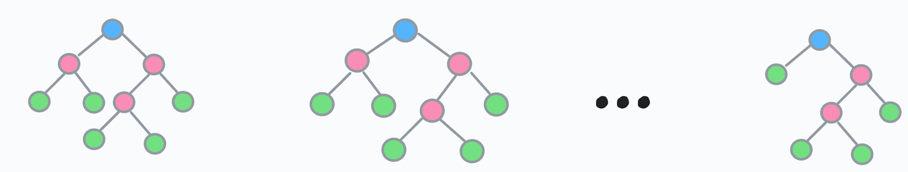
Random Forest
Random Forest is an ensemble of decision trees algorithms that can be used for classification and regression predictive modeling.
Prediction

Slide 18
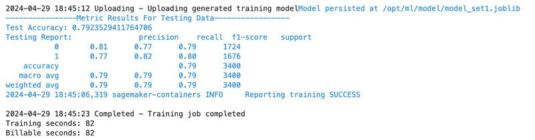
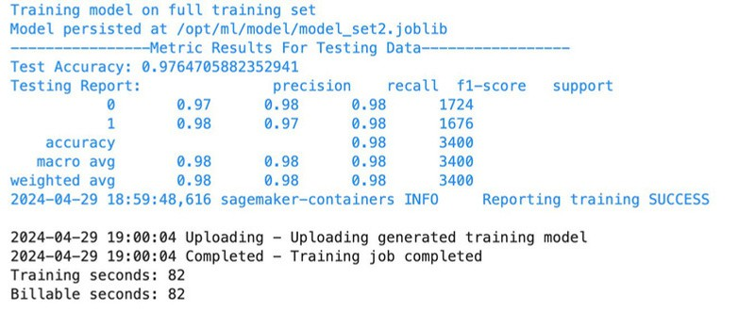
Random Forest Results
Metric | SET 1 | SET 2
Accuracy | 0.79 | 0.97
Precision | 0.79 | 0.98
Recall | 0.79 | 0.98
F1 Score | 0.79 | 0.98

Slide 19
Cross
Validation
Folds | Scores
Fold1 | 0.9776
Fold2 | 0.9761
Fold3 | 0.9805
Cross Validation
Mean CV Score : 0.9772
Standard Deviation of CV scores : 0.0017

Slide 20
Thank You
GitHub: https://github.com/BVishal-Geek/Cloud-SageMaker

